Slide 1
Saving your bacon

Slide 2
Source Control
Source control allows you to track the changes you make to a bunch of files
You've probably got your own version of source control already
  MyDocOfAwesome_25.1.2015.doc
  MyDocOfAwesome_26.1.2015.doc
  MyDocOfAwesome_25.1.2015.doc.bak
And a Dropbox folder of stuff you share between team-mates

Slide 3
Source Control
Renaming files is fine for school essays, but for a game project? No hope...
  Code won't compile properly with loads of date info in the file name
  Unity scenes don't merge particularly easily
  Working with other people is problematic...
  FUUUUUU! Someone saved over my textures... :(

Slide 4
Source Control
So what are the benefits?
  Backup and Restore: Files changes are saved, need a copy of the file from 2 weeks ago? No problem...
  Syncronisation: Need to share the project among a team? No problem...
  Undo: Someone's saved over your textures? Just revert the change...
  Blame: Want to point at the person who saved over the textures? No problem...

Slide 5
Source Control
There's also one other aspect of Source Control that's very handy:
  Branches
Allow you to take the project in a different direction, work in isolation, make big changes, then merge back into the “main” project at a later date

Slide 6
Source Control
There's some jargon:
  Repository: The database storing all your files
  Revision: one of the versions of your files
  Head: The latest version of all files
  Check-in: saving a version to the database
  Check-out: downloading a version from the database
  Sync: making sure you have all the latest changes

Slide 7
Source Control
Revert: Throw away some changes
Branch: Create a separate copy of the database
Merge: Apply some changes to your version of the database
Conflict: Where 2 sets of changes contradict each other
Resolve: fixing these changes

Slide 8
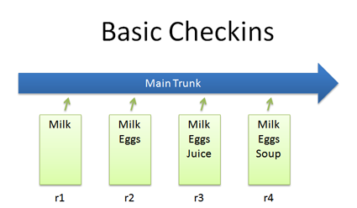
Source Control

Slide 9
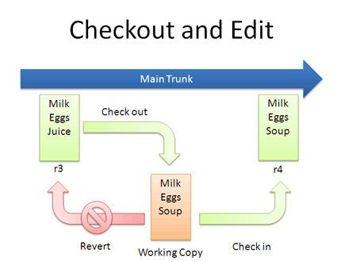
Source Control

Slide 10
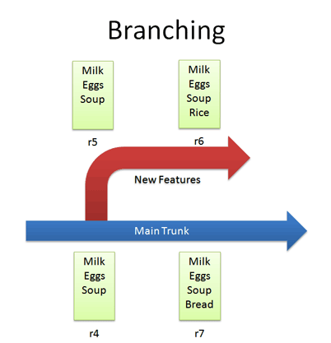
Source Control

Slide 11
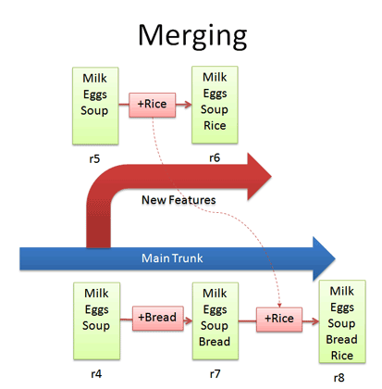
Source Control

Slide 12
Source Control
Where to go:
  Two main choices
    GitHub
    BitBucket
  Both are free.
  Bitbucket has the advantage of allowing private respositorys

Slide 13
Source Control
http://bitbucket.org
http://github.com
Register at one!
Download Source Tree app:
  http://sourcetreeapp.com

Slide 14
Bit Bucket
I suggest you register at both.
Github has many open source projects on, good place to be
Bitbucket allows you to dev your games in private. Essential if you're working for someone

Slide 15
Bit Bucket
You should create a repository for each project you work on. DON'T just have all your work in one respository (it'll get too big)
So, register on Bitbucket and I'll walk you through it...

